Slide 1
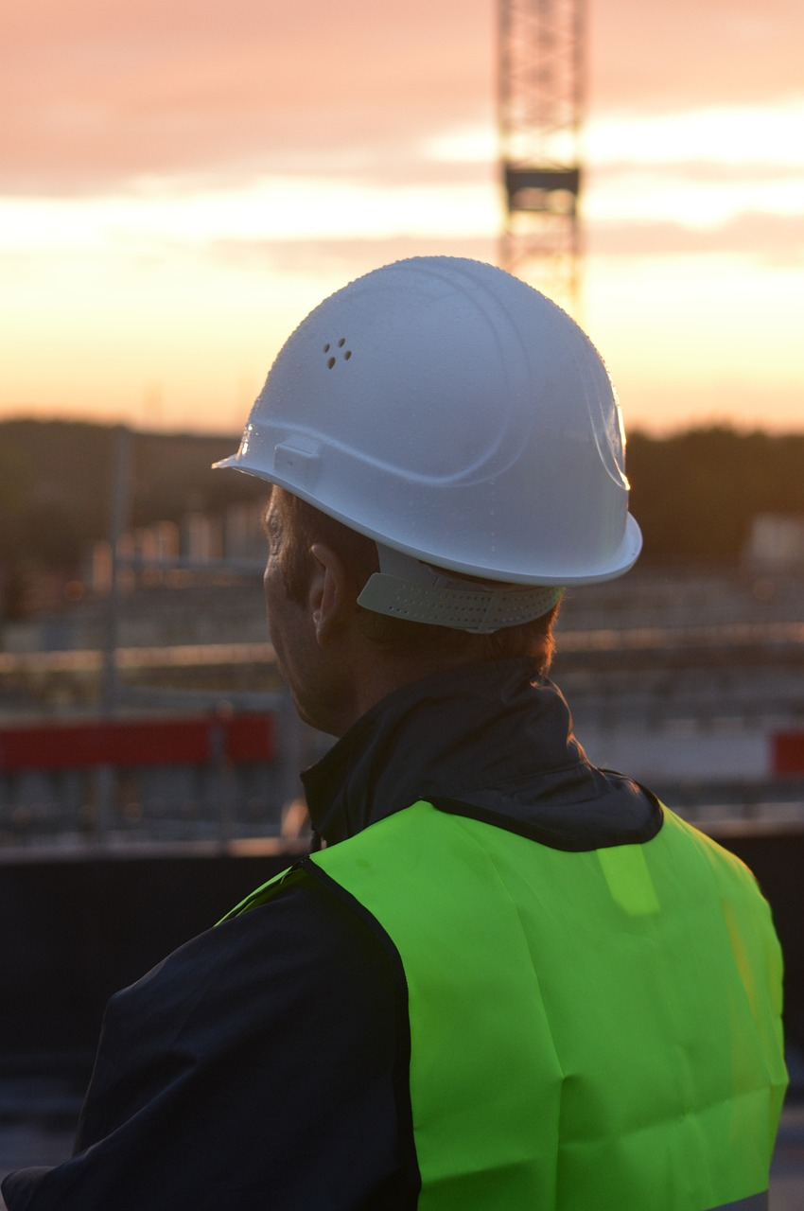
Safety detection

Slide 2
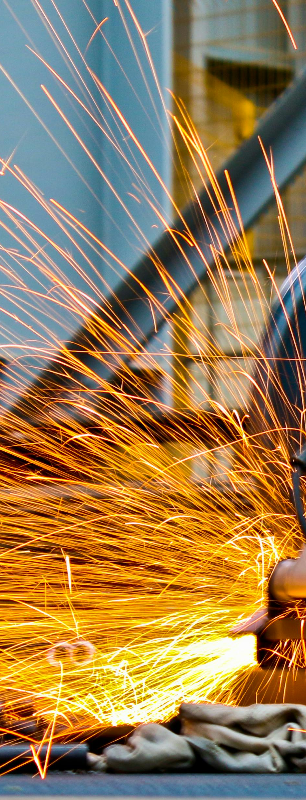
Ramy Zaky Abd El Aty 2000596
Osama ElSayed Ibrahim 2001208
Hussein Farag Fathy 2000604
Ahmed Nasser Fekry Abdullah 2000283
Mohamad El Sebaei Mahmoud 2001263
Yousef Mohamed Ramadan 2000279
Maram Amr mohamad 2000473
Working Team
Supervied By
Dr. Rodaina Abdelsalam
Eng. Rana

Slide 3

Outline
Introduction
Problem Statement
Related Work (Papers)
Methodology of Proposed Approach
Research Objectives
The Website
Time Plan
Architecture of Laser Security System
Benefits of Laser Security Systems
Conclusion
References

Slide 4
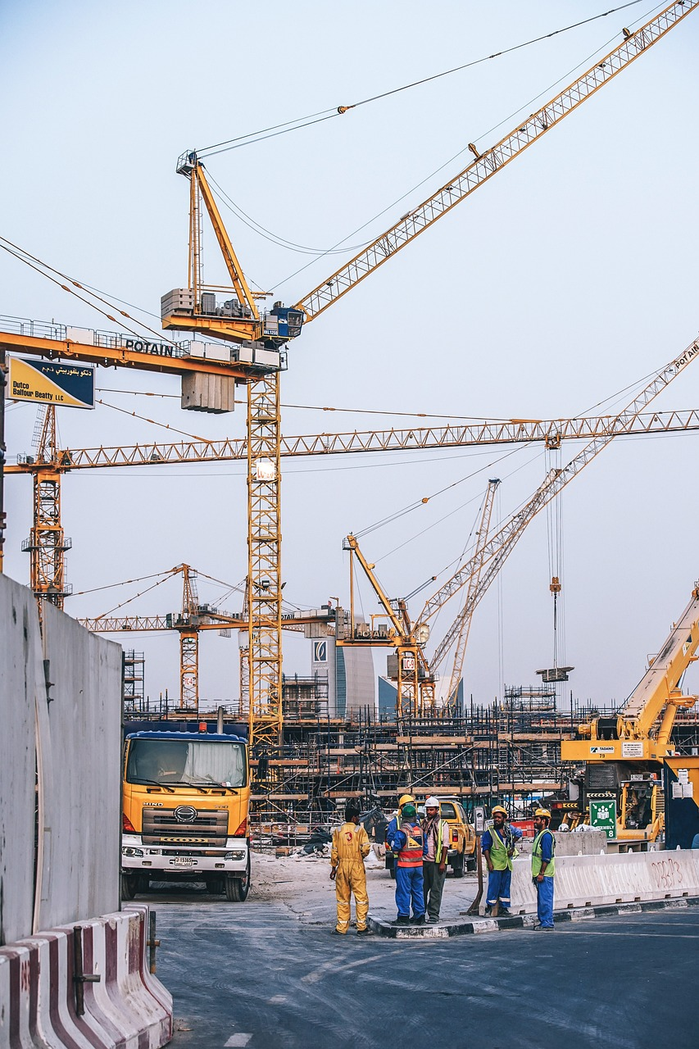
Introduction
Artificial intelligence has seen significant development, and we need it for use in the field of safety to protect workers from the risks of not following safety procedures.
These systems can identify potential hazards, monitor worker activities, and predict unsafe conditions with a level of accuracy and efficiency.
By combining the artificial intelligence with construction site safety, we can build a safe environment .

Slide 5
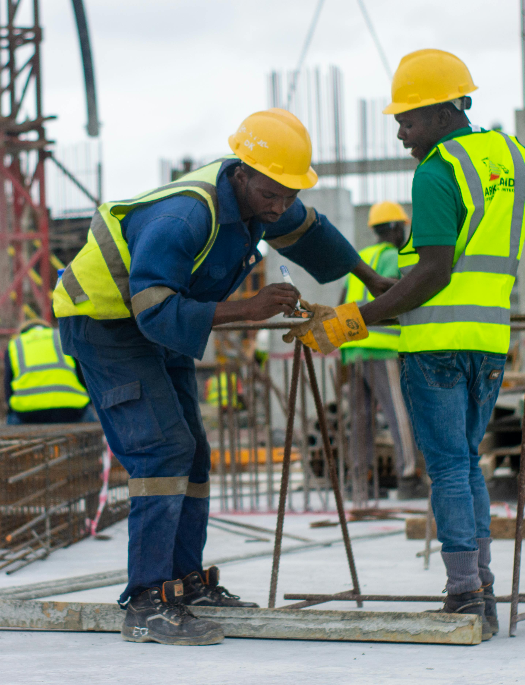
Problem Statement
Many accidents occur at construction sites due to workers' negligence and failure to follow safety procedures, jeopardizing people's lives. We are attempting to employ artificial intelligence to help reduce these accidents and safeguard human lives.
One of the most crucial safety measures that workers must adhere to is wearing helmets and protective clothing. We will try to utilize the YOLO algorithm to assist in addressing this issue.

Slide 6

Algorithms TO help in safety detection

Slide 7
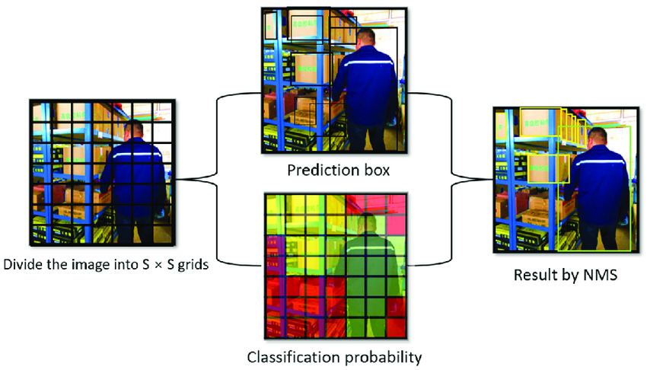
YOLO (You Only Look Once):
YOLO is a state-of-the-art object detection algorithm that stands out for its real-time processing capabilities. In the realm of construction site safety
YOLO can be employed to swiftly and accurately identify potential hazards or monitor the activities of workers. Its efficiency lies in its ability to process images or video frames in one pass, making it well-suited for applications requiring quick and continuous analysis.

Slide 8
Related Work
Name Paper | Dataset Classes | Algorithm | Accuracy
1st paper | (Hat, vest, worker hat and vest, worker_only_hat, worker_only_vest, Unsafe Worker) | Yolov3 | (Hat): 79.33% (Vest): 83.01% (Hat + Vest): 67.93%
2nd paper | (Helmet) | CNN(TensorFlow) | Accuracy : 80%
3rd paper | (Helmet) | Yolov3 Yolov4 | Yolov3 : 75% Yolov4 : 79%
4th paper | (Helmet, No Helmet) | Yolov5 | Accuracy : 86%
5th paper | (Helmet, No Helmet) | Yolov5 | Accuracy : 92%
Know your material in advance
Anticipate common questions
Rehearse your responses
Maintaining composure during the Q&A session is essential for projecting confidence and authority. Consider the following tips for staying composed:
Stay calm
Actively listen
Pause and reflect
Maintain eye contact

Slide 9
Methodology of Proposed Approach
Used algorithm in deep learning:
- Yolov8 is a state-of-the-art model for object detection, instance segmentation, and classification. It has several advantages over Yolov3, Yolov4 and Yolov5, such as:
- It can handle higher-resolution images and detect smaller objects more accurately.
- It has a friendly interface via a PIP package, which makes it easy to use and deploy.

Slide 10
Research Objectives
Collecting
Collecting information about accidents related to safety equipment,
Gathering
gathering data and insights from relevant studies,
Selecting
selecting the most suitable machine learning algorithms and frameworks,
Identifying
identifying an appropriate dataset for training the model.
Constructing
constructing a model capable of detecting images.

Slide 11

Website
Built Using Html, CSS, Bootstrap and Flask

Slide 12



About us

Slide 13

Website Overview

Slide 14

Login System
built using
flask-login, wtforms and SQLAlchemy

Slide 15

Sign Up

Slide 16
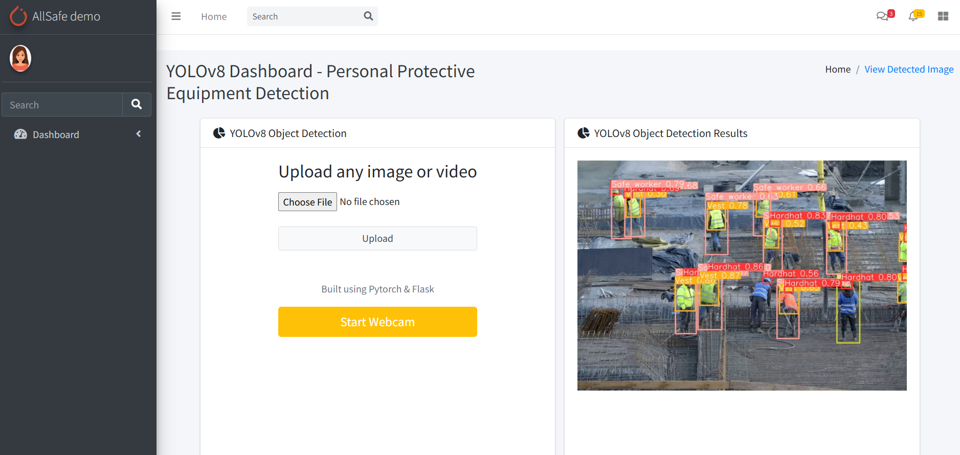
Safety Detection Page

Slide 17
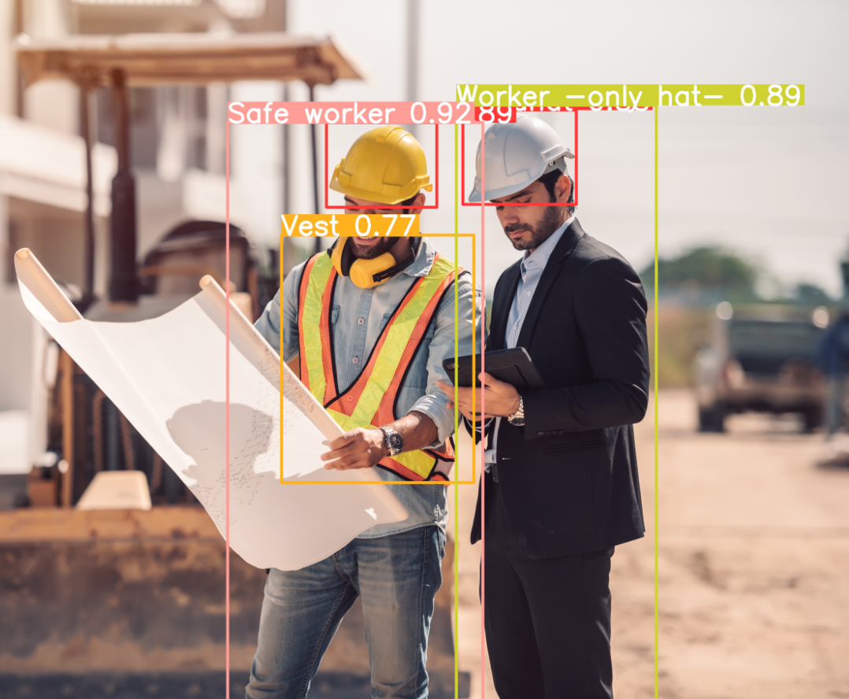
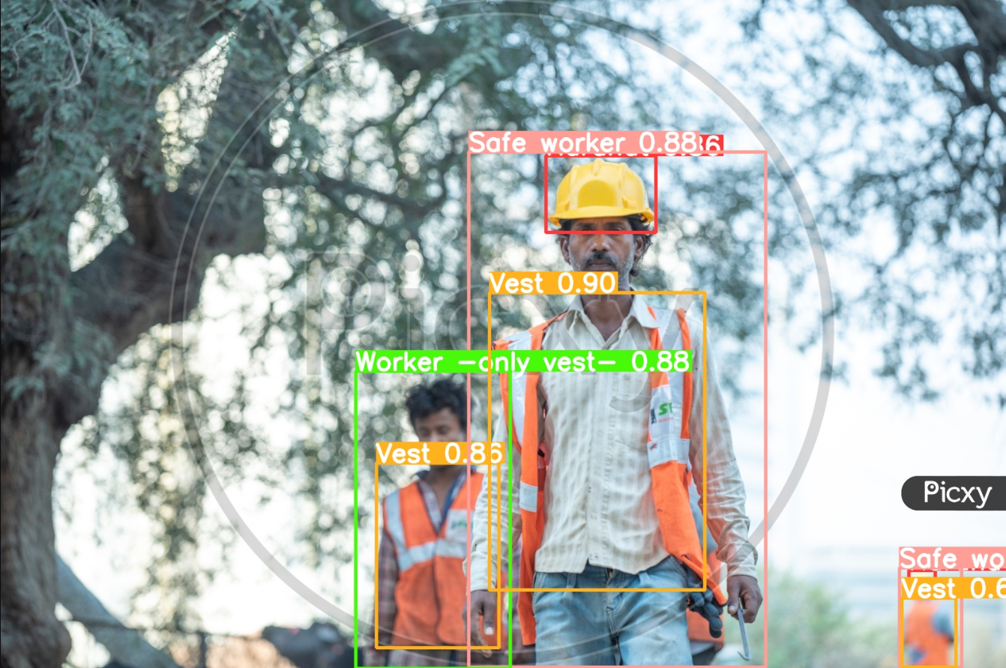
Results of the model

Slide 18
Website Overview cont. (video)

Slide 19
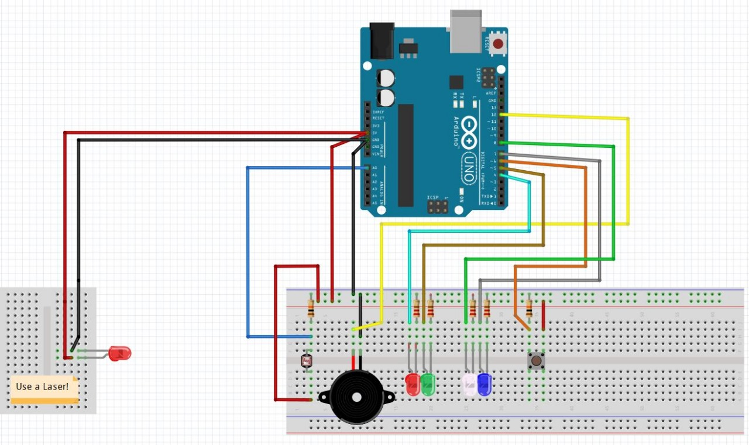
Architecture of Laser Security System

Slide 20
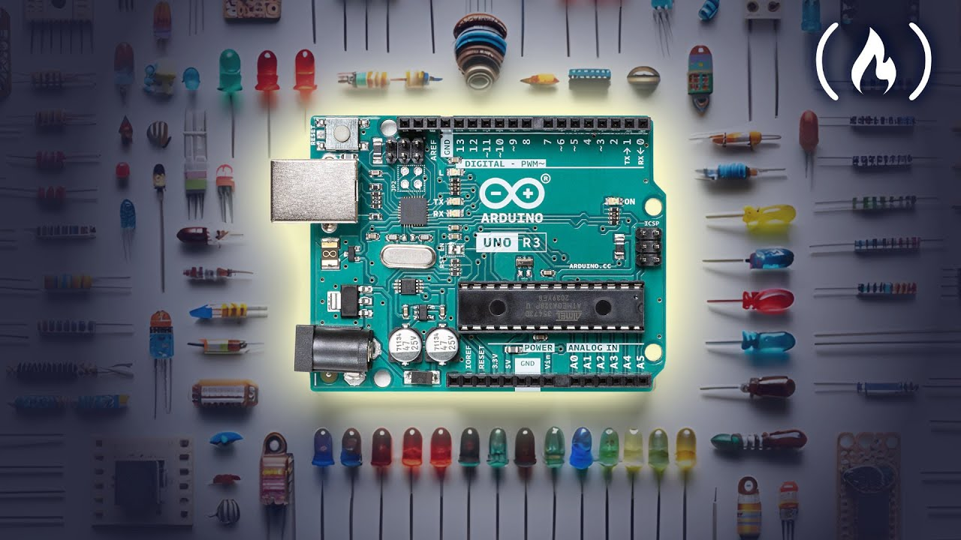
Benefits of Laser Security Systems
1. High Precision: Laser beams provide precise detection capabilities, allowing for accurate identification and tracking of safety objects such as obstacles, vehicles, or individuals.
2. Fast Response Time: Laser sensors can detect objects in real-time, enabling rapid response to potential safety hazards or emergencies.
3. Customization: These systems can be customized to detect specific types of safety objects or to cover specific areas, ensuring comprehensive safety coverage tailored to the environment.
4. Continuous Monitoring: Laser security systems can continuously monitor the surroundings, providing constant vigilance against safety threats.

Slide 21
Benefits of Laser Security Systems
5. Alert Systems: They can be integrated with alert systems to promptly notify operators or trigger safety protocols in the event of an object detected within the protected zone.
6. Reduced False Alarms: Laser technology minimizes false alarms by accurately distinguishing between safety objects and other environmental factors like wind-blown debris or animals.
7.Enhanced Safety Measures: By reliably detecting safety objects, laser security systems contribute to the implementation of proactive safety measures, helping to prevent accidents and injuries

Slide 22

Time Plan

Slide 23

Source of data
From roboflow
https://universe.roboflow.com/projet-dinitiation-s3gke/ppe-eulup/dataset/5
Dataset : 5978 image
Class Names = ["Hardhat", "Safe worker", "Unsafe worker", "Vest", "Worker -only hat", "Worker -only vest"]
Accuracy of model : 95%

Slide 24
Conclusion
Our Safety Detection Model excels in accuracy , adaptability and effectively minimizing the risk of accidents.
We will continue improving the model by user feedback and experts in the field
special thanks to our dedicated team, mentor, and supervisor for their invaluable contributions.

Slide 25
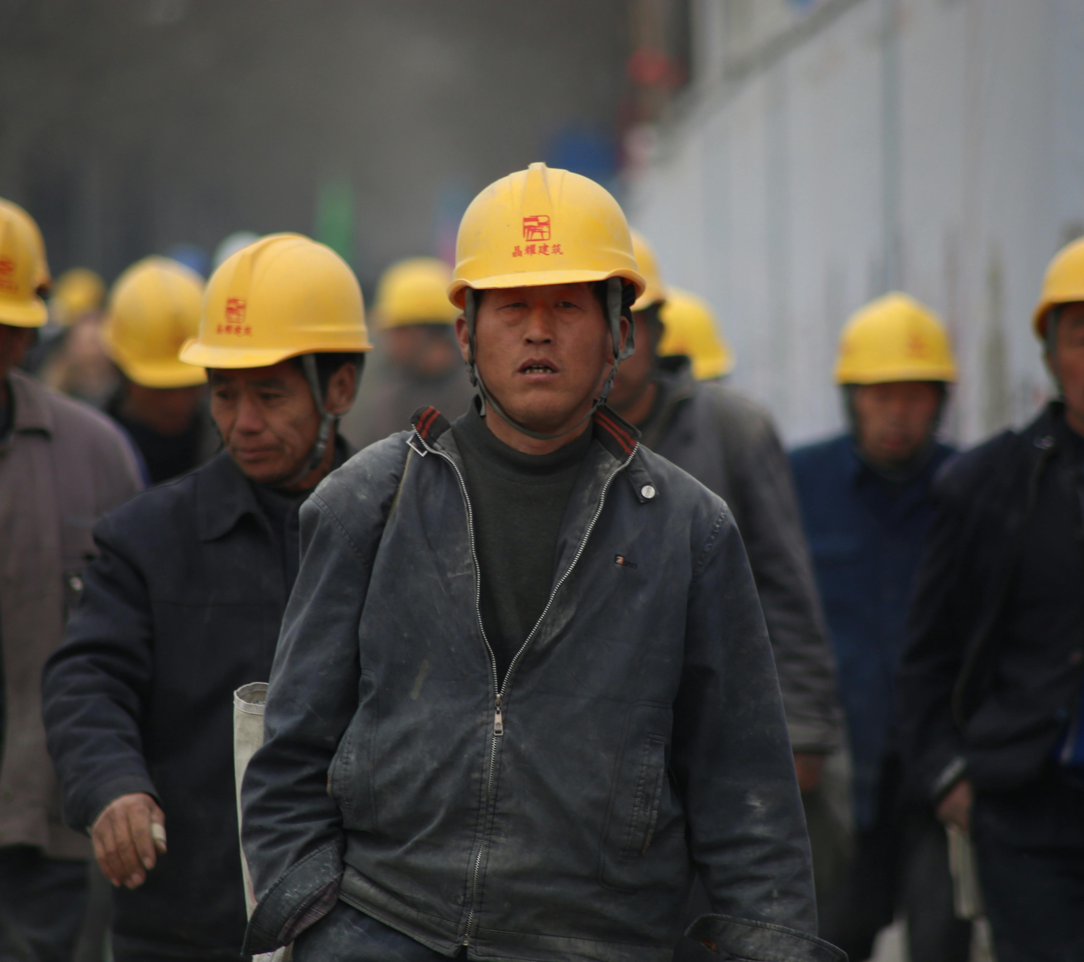
THANK YOU

